Slide 1
Forest Fire Detection Using Image Processing
Submitted by:
Harsh Agarwal (18IT117)
Adarsh Naidu (18IT102)
Amith Bhat Nekkare (181IT105)

Slide 2
Introduction
A forest fire is a phenomenon which can be defined as an uncontrolled fire in an area of combustible vegetation. They can result in a great number of environmental disasters, causing vast economical and ecological losses. In order to prevent this, forest fire monitoring and detection have become a significant solution, which attract an increasing interest around the world.
Conventional forest fire detection techniques make use of watchtowers and human observers to search and observe fires. It consumes tremendous labour, threatens observers’ safety and costs a great deal of time.

Slide 3
Introduction
Owing to the development of modern technologies, more advanced forest fire detection approaches include integrating remote sensing techniques with various platforms (such as satellites, ground-based equipments, and aircrafts), which are designed to overcome drawbacks of traditional methods.In our project, we propose a method to detect fires from a picture taken by UAVs, drones, etc. by using image thresholding.Thresholding is a method used to partition images on the basis of some input parameters.

Slide 4
Literature Survey
Sl No. | Paper Title and Author | Work Done
1. | C.Yuan,Z.Liu and Y.Zhang,”Fire detection using infrared images for UAV-based forest fire surveillance”, 2017 International Conference on Unmanned Aircraft Systems (ICUAS), IEEE Xplore. | A paper which deals with fire detection using IR images for UAV-based devices. In this paper, an algorithm which makes use of brightness and motion clues along with histogram-based segmentation and optical flow approach for fire pixels detection is used for detecting fire in IR video sequences.
2. | M.Srutek and T.Andrysiak, Flame Detection based on Infrared Images,Problemy Exploatacji – Maintenance Problems,2-2013. | A method for the detection and localization of flames with the use of infrared images, was proposed.

Slide 5
Literature Survey
Sl No. | Paper Title and Author | Work Done
3. | J.Seebamrungsat,S.Praising,P.Riyamongkol, Fire detection in the buildings using image processing, 2014 Third ICT International Student Project Conference (ICT-ISPC), IEEE Xplore. | An algorithm to detect different types of burning objects, by analyzing their burning temperature, is proposed.

Slide 6
Objectives
To automatically detect forest fires around the world by using infrared(IR) images sourced from satellites and other sources using different Image Processing Techniques.

Slide 7
Requirement Analysis
Hardware Requirements
Processor: Intel Pentium IV or above
RAM: 2 GB or above
Software Requirements
Operating System: Windows 7 / Ubuntu 14.04/ Debian or above
Python 3.6 or above
OpenCV, Imutils Libraries

Slide 8
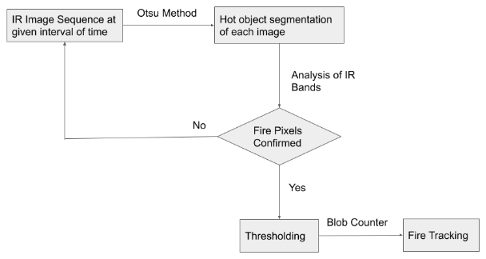
Methodology

Slide 9
Methodology
The input is an infrared image which may or may not have fire pixels in it.
We then perform the hot object segmentation, which divides the image parts on the basis of heat emitted, on the input image. Upon analysis of the identified IR bands, we can detect the fire pixels, if it exists.

Slide 10
Methodology
If no fire pixels are found, the next input image is called for and the process starts again. Else, binary thresholding is performed on the fire pixels to identify those fires whose heat is above a particular heat and area value to remove human settlements,etc. from consideration. Finally, a blob counter is used and an output image is returned with the identified fire spots.

Slide 11
Design Analysis
Input of Dataset
The images for processing are stored in a separate folder.
Contour/Edge Detection
The points at which image brightness changes sharply are typically organized into a set of curved line segments termed edges.
The result of applying an edge detector to an image may lead to a set of connected curves that indicate the boundaries of objects.
Pixel Intensity Detection
The pixels are converted into grayscale values by taking average of all the three RGB values and the intensity is compared.

Slide 12
Design Analysis
D. Detection of Fire
To reveal the brightest regions in the blurred image we need to apply thresholding: This operation takes any pixel value p >= 200 and sets it to 255 (white). Pixel values < 200 are set to 0 (black).
We perform connected component analysis on the resulting image to identify blobs of bright regions and label them with a number. All these blobs are iterated through and any blob with less number of pixels are discarded.
These blobs are highlighted with a red circle and overlapped on the original image.

Slide 13
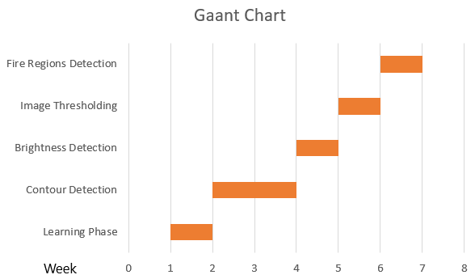
Timeline/Gantt Chart

Slide 14
Conclusion
The program is successfully able to detect the forest fire.An image of a forest is taken as input and the output image will highlight the areas of fire according to the heat intensity.
The required fire regions will be encircled and each region will be mapped to its count.The program also works for regular coloured images in addition to grayscale Infrared Images.
The program was tested on a set of over 100 different sized images and by analysis, the overall efficiency is coming out to be around 90% .

Slide 15
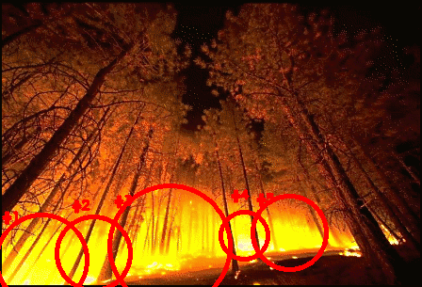
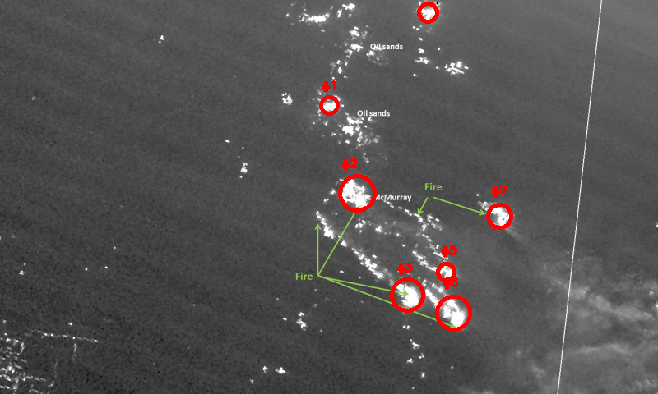
Conclusion

Slide 16

Thank You!

